Slide 1

SIR M VISVESVARAYA INSTITUTE OF TECHNOLOGY International Airport road, Hunasamaranahalli, Yelahanka,
Sir M Visvesvaraya Inst Road, Yelahanka, Bengaluru, Karnataka 562157
PROJECT: AUTOMATED DISEASE DETECTION SYSTEM USING ML
Under the Guidance Presented By
Mrs. VANI HARAVE HARISH GOUDA
Assistant Professor 1MV23MC020
Dept. of MCA

Slide 2
TABLE OF CONTENTS
CONTEXT DIAGRAM
DATA FLOW DIAGRAM
USE CASE DIAGRAM
ER DIAGRAM
FLOW CHART
SEQUENCE DIAGRAM
ACTIVITY DIAGRAM
DATASET SAMPLE

Slide 3
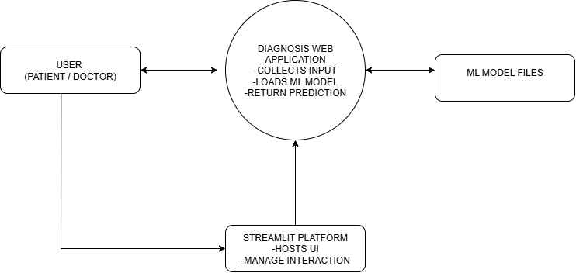
CONTEXT DIAGRAM

Slide 4
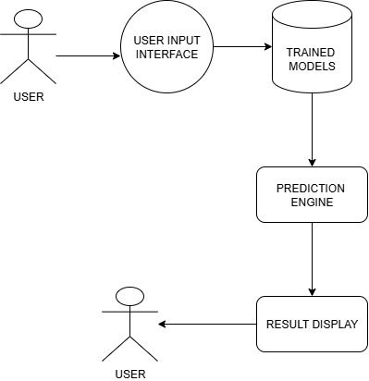
DATA FLOW DIAGRAM
LEVEL 1

Slide 5
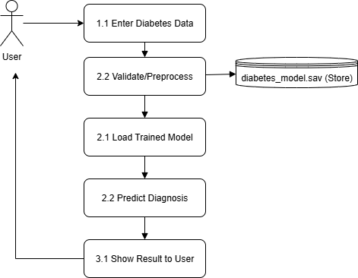
DATA FLOW DIAGRAM
LEVEL 2

Slide 6
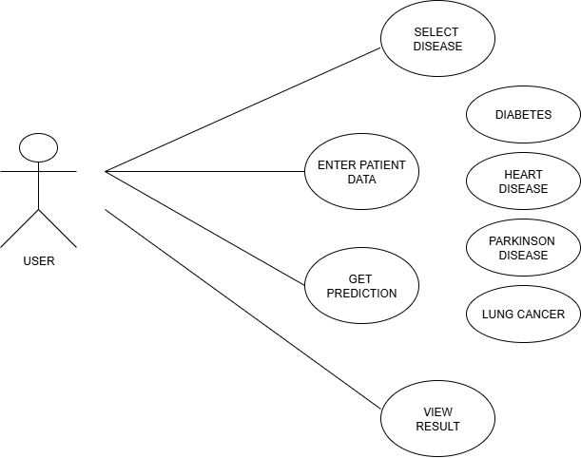
USE CASE DIAGRAM

Slide 7
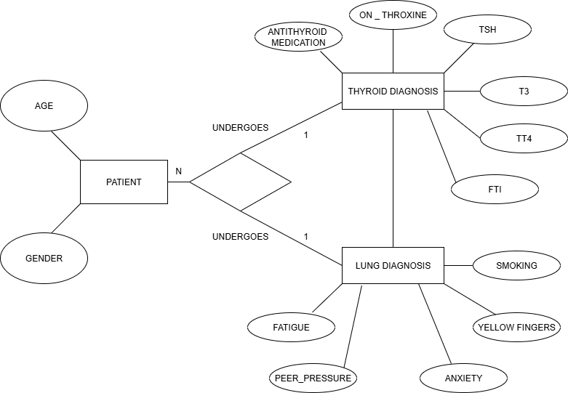
ER DIAGRAM

Slide 8
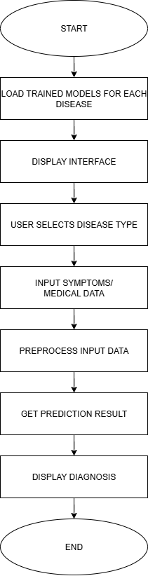
ALGORITHM- FLOWCHART

Slide 9
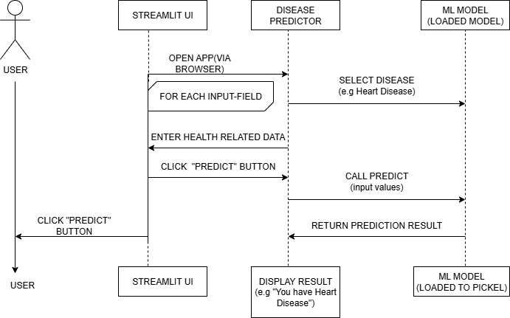
SEQUENCE DIAGRAM

Slide 10
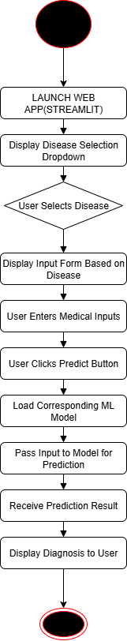
ACTIVITY DIAGRAM

Slide 11
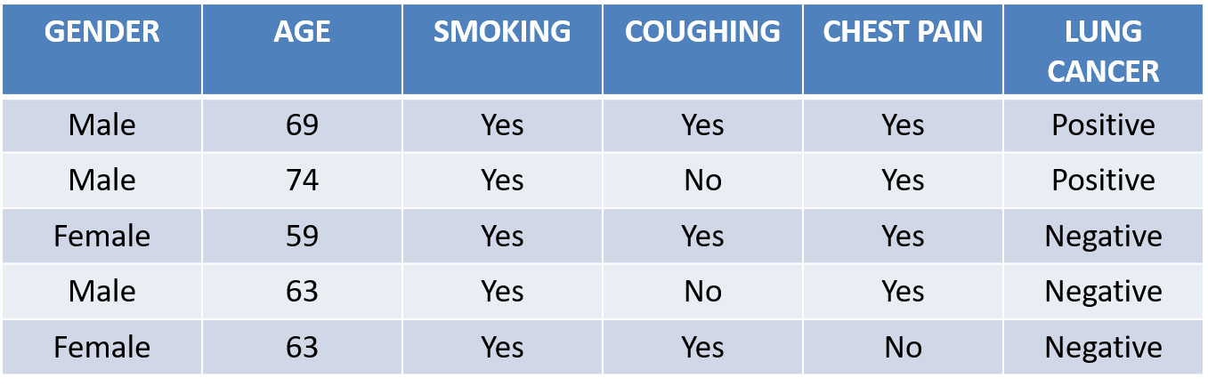
SAMPLE DATASET

Slide 12


